Slide 1


Project I: H1B Visa
Spencer Stucky, Cheng Zeng, Wenyu Zeng, Chao Zhou
10.22.2019

Slide 2
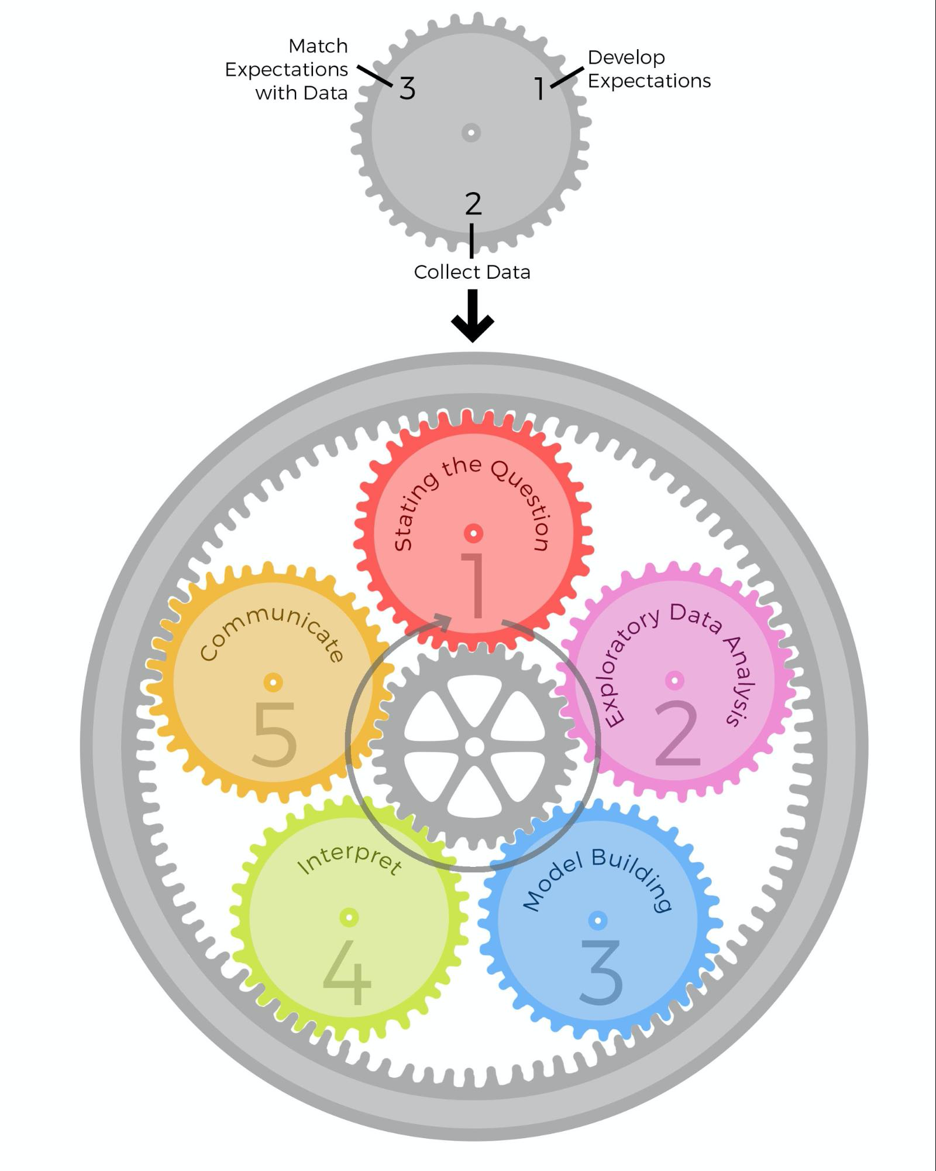

Slide 3
Overview
What key factors affect approval rate of H1B visa
Introduction of H1B visa
Data Summary
Data Interpretation
Communication

Slide 4
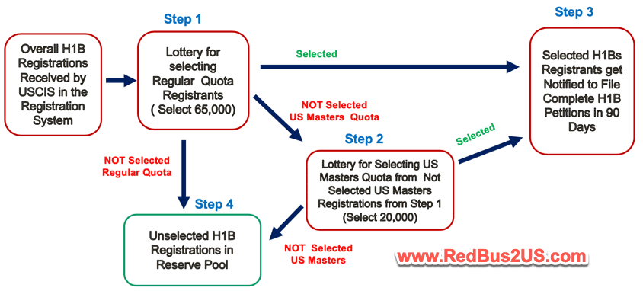
Introduction of H1B Visa
Visa for Temporary (Nonimmigrant) workers
About 20 different types of temporary worker visa
Average of half a 1,000,000 petitions for foreign workers each year
190,098 petitions for H1B visa in 2019
65,000 Regular cap and 20,000 Master’s cap

Slide 5
Data Summary
Where we get it:
USCIS stands for U.S. Citizenship and Immigration Services
What this data is about:
CSV file, row, column, we will take a look together
How we clean it:
Although it is csv file, we still need to dig into the data to clean it

Slide 6
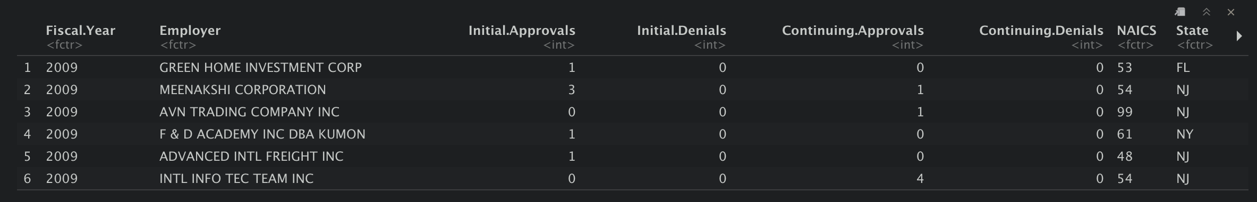
Questions:
How is approval rate associated with location of employer?
How is approval rate associated with Industry(NAICS)?
How is approval rate associated with Fiscal.Year?

Slide 7
Location

Slide 8
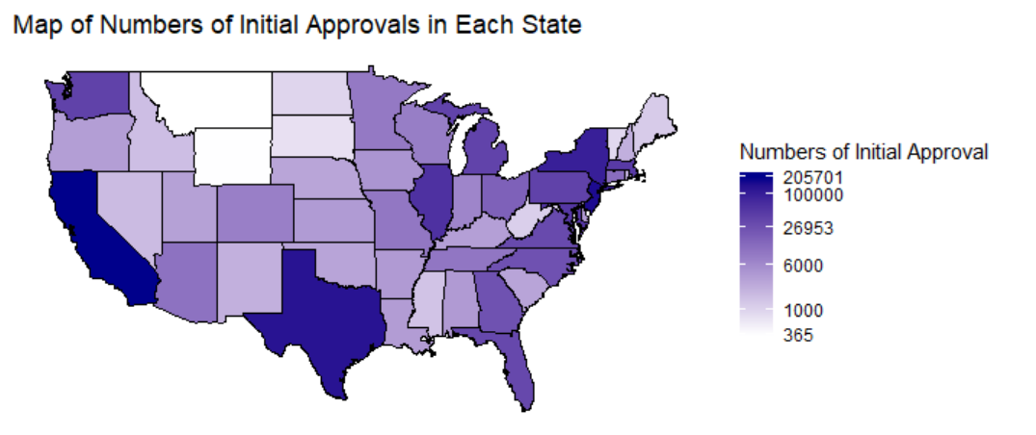
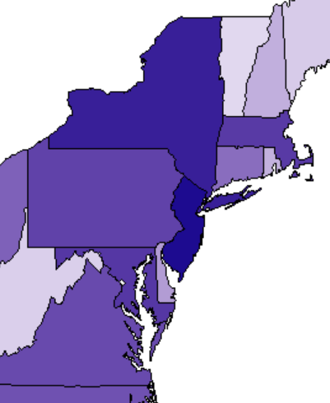
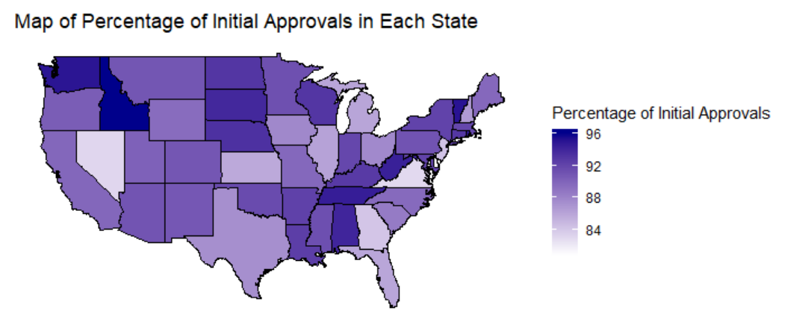
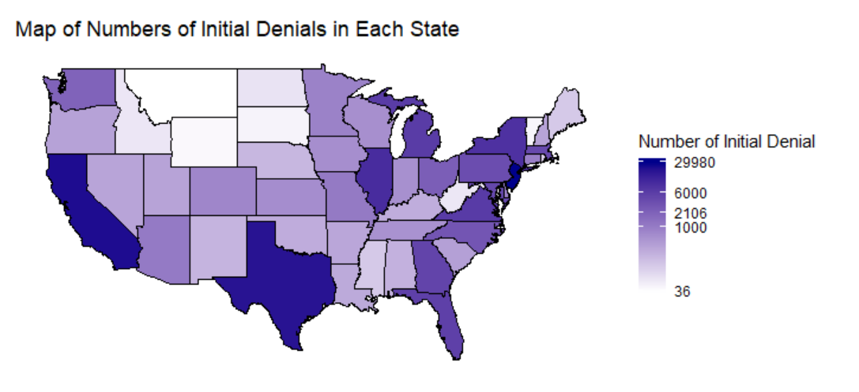
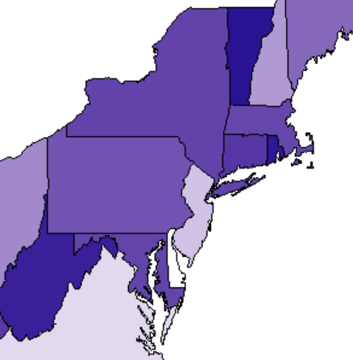
Factor I - Location Vs. Initial Approvals
NY
MA
NJ
CA, NJ, TX, NY and IL are the top five states that have large number of initial approvals
ID, VT, WA, RI and TN are the top five states that have high percentage rate
DE*
WA
MD
CA
TX
VT
RI
WA
ID
AL
MA
TN
WV
DE*

Slide 9
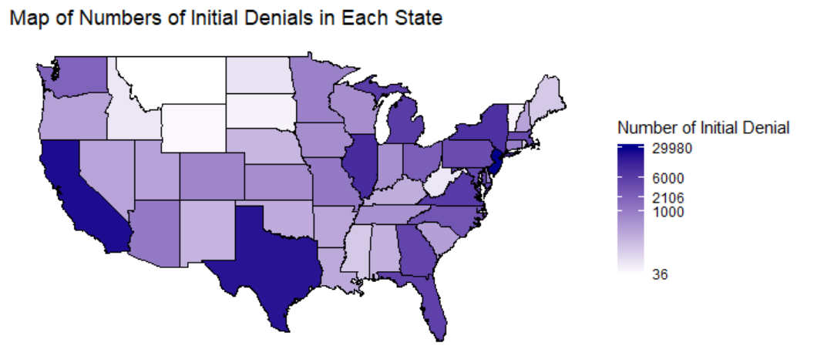
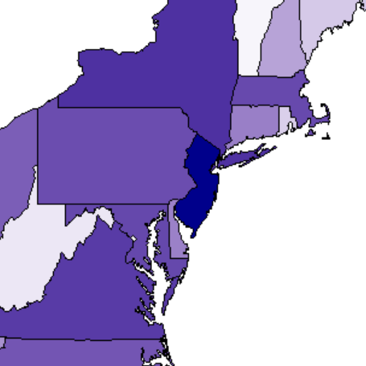
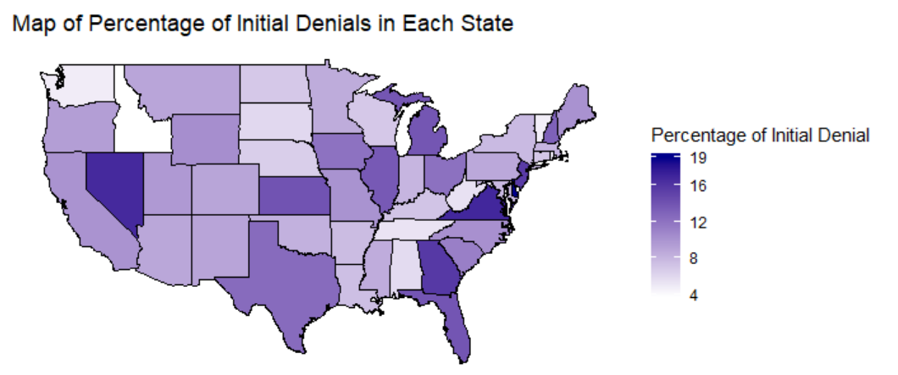
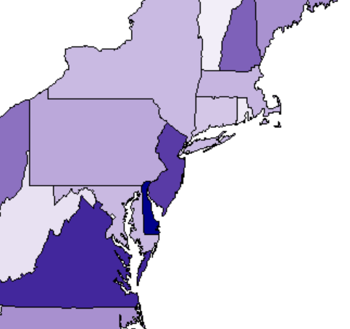
Factor I - Location Vs. Initial Denials
MT
ND
VT
ID
WV
WY
SD
VT
WA
ID
WV

Slide 10
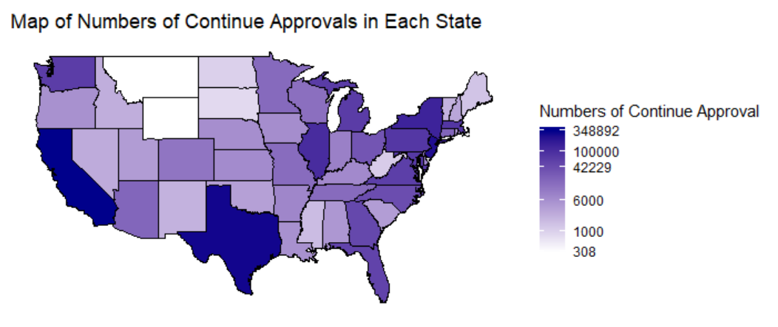
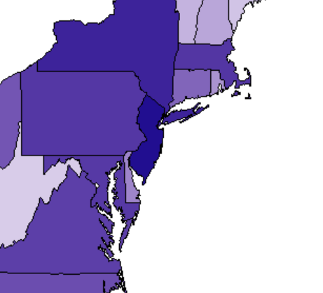
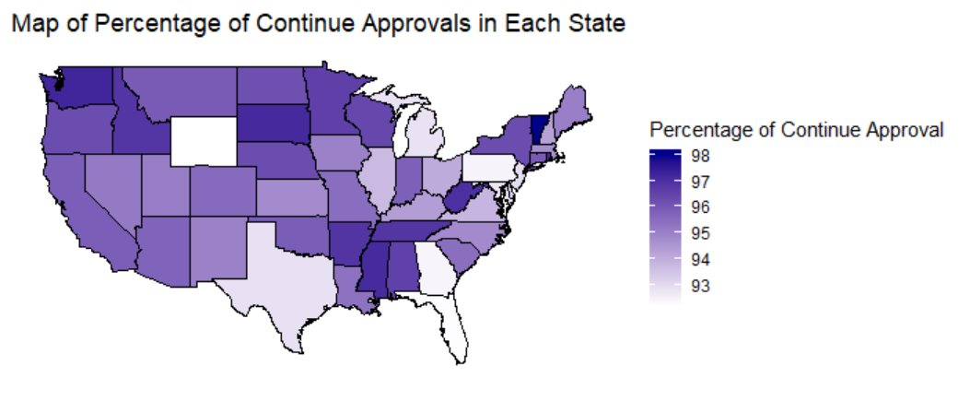
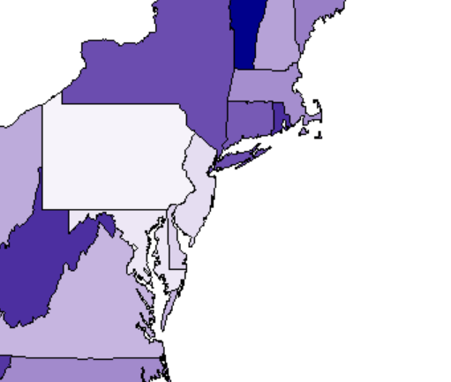
Factor I - Location Vs. Continue Approvals
NY
MA
CA, NJ, TX, NY and IL are the top five states that have large number of continue approvals
VT, WA, SD, MS and RI are the top five states that have high percentage rate
NJ
WA
PA
CA
MD
TX
VT
TN
MS
WV
WA
ID
MS
SD

Slide 11
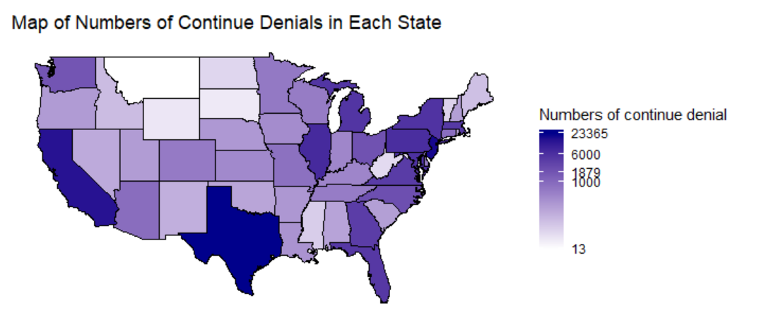
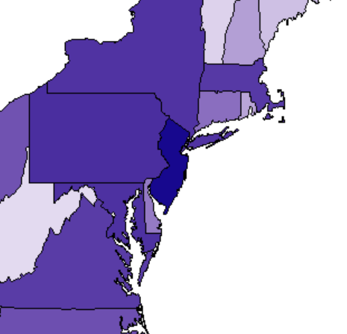
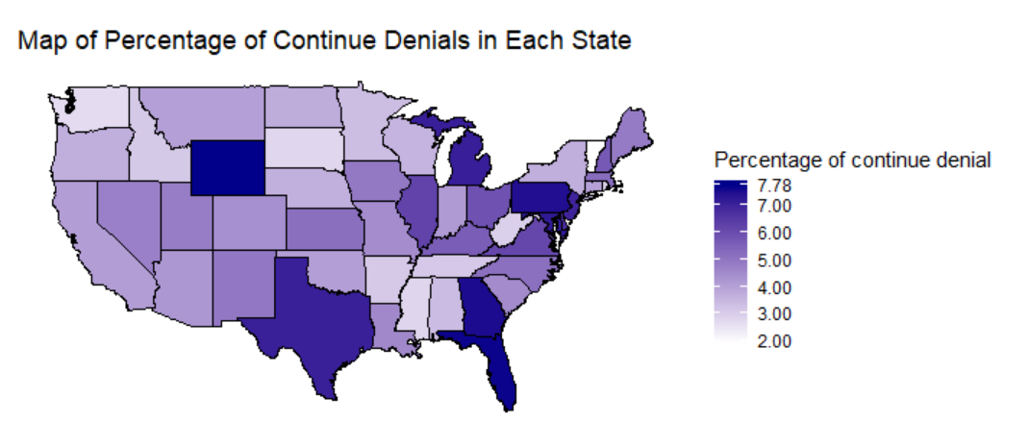
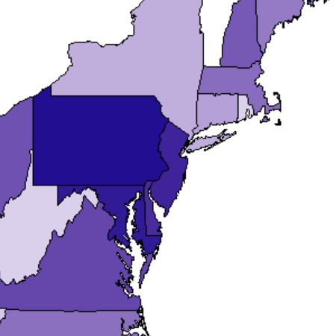
Factor I - Location Vs. Continue Denials
MT
VT
ID
WV
WY
SD
MS
VT
WA
ID
WV
SD
MS

Slide 12
Industry

Slide 13
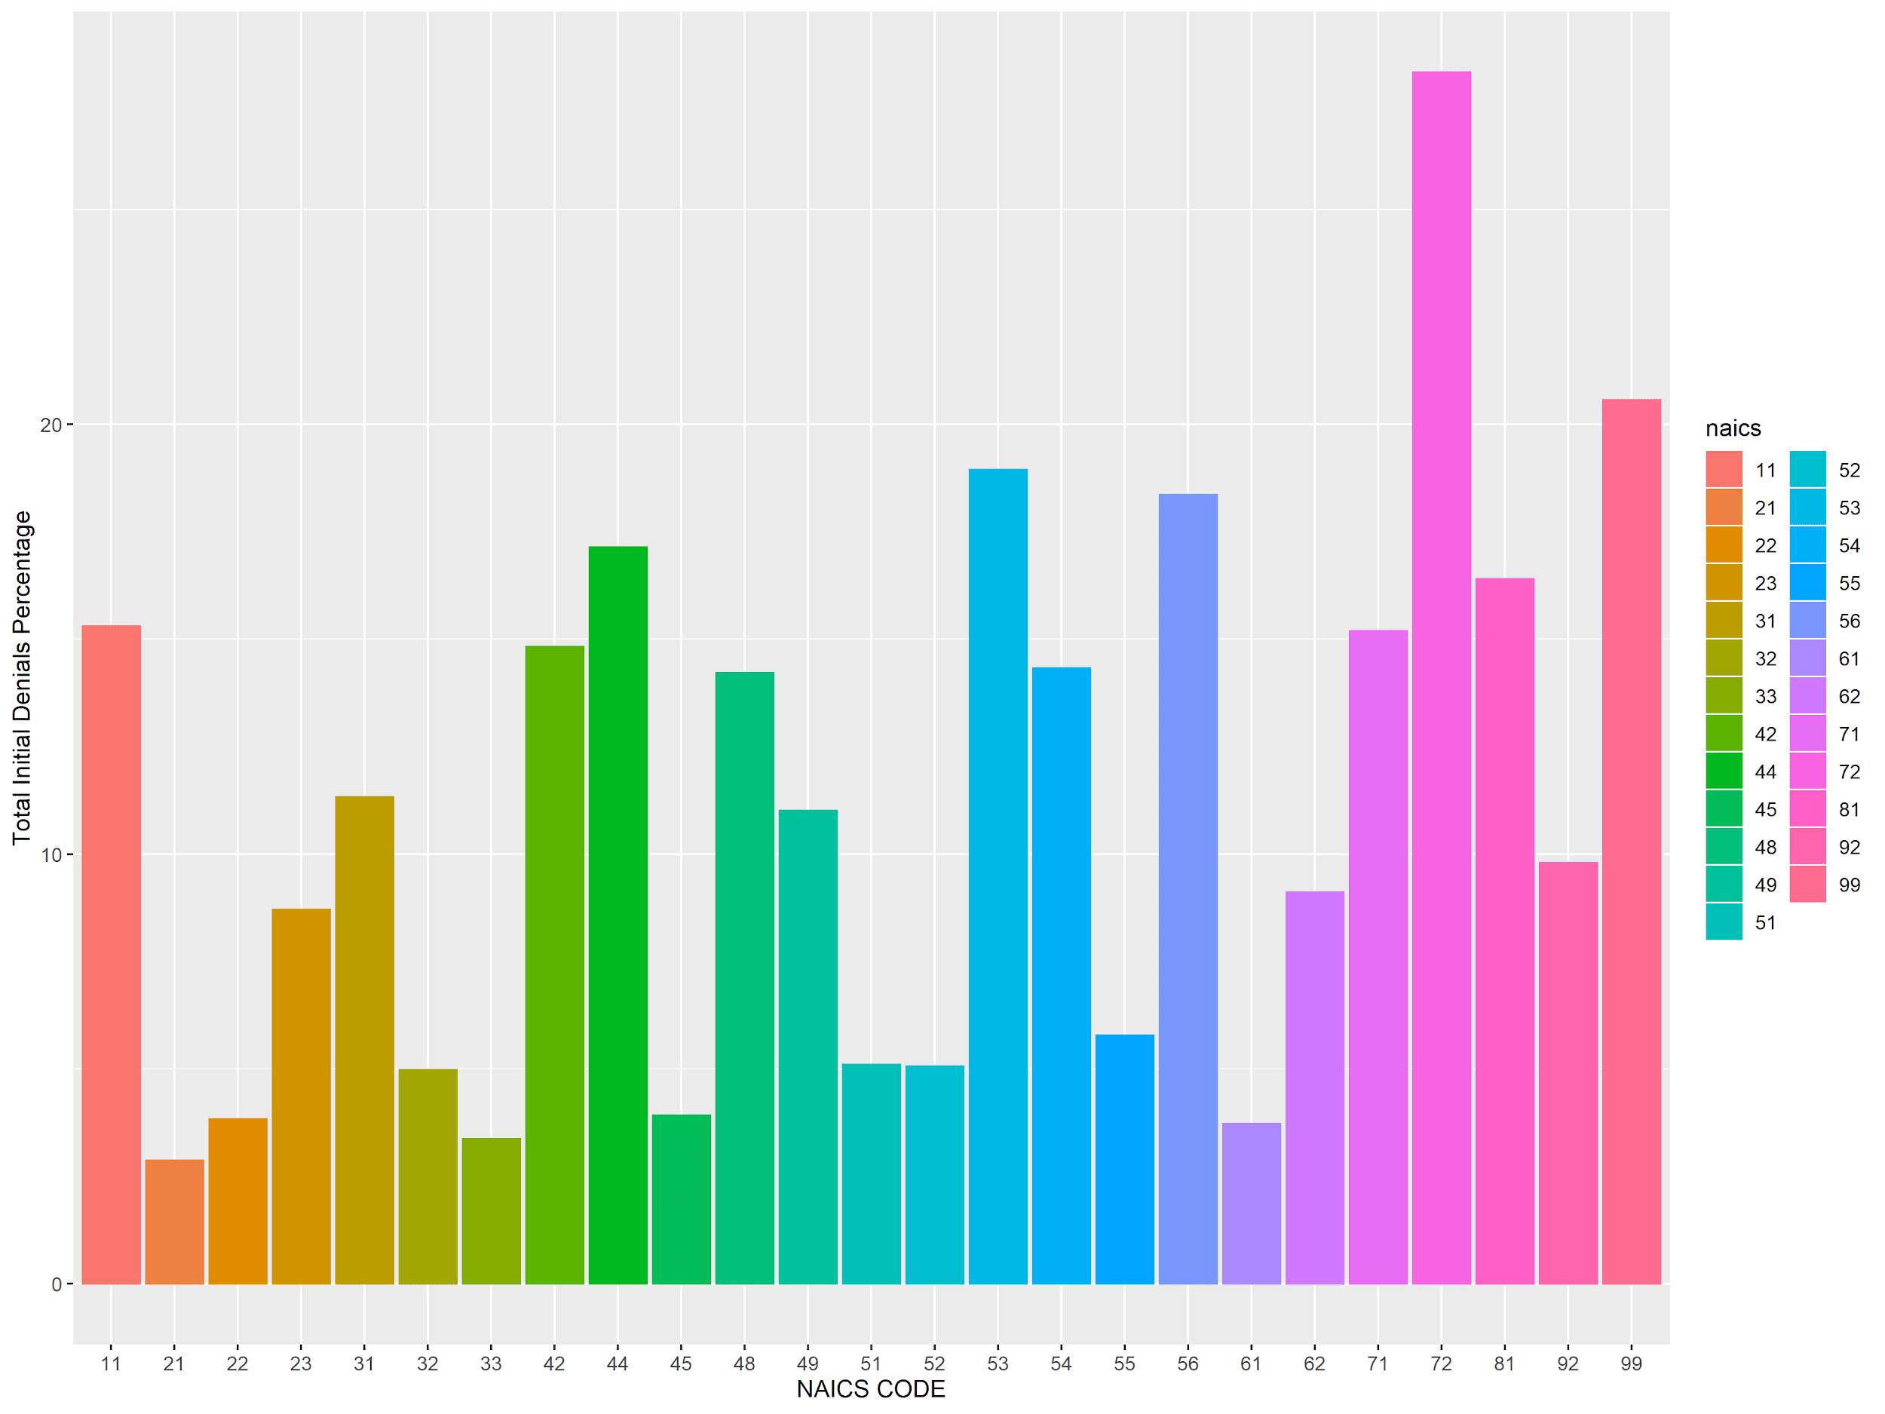
Factor II - Industry
Industries vs NAICS
Total Initial Denial Percentage
21(Mining):
Mining industry employees are in demand
Skilled-labor shortage
72(Accommodation and Food Services):
Small Business (Low end job position)
Temporary Non-agricultural Worker Visa (H-2B)

Slide 14
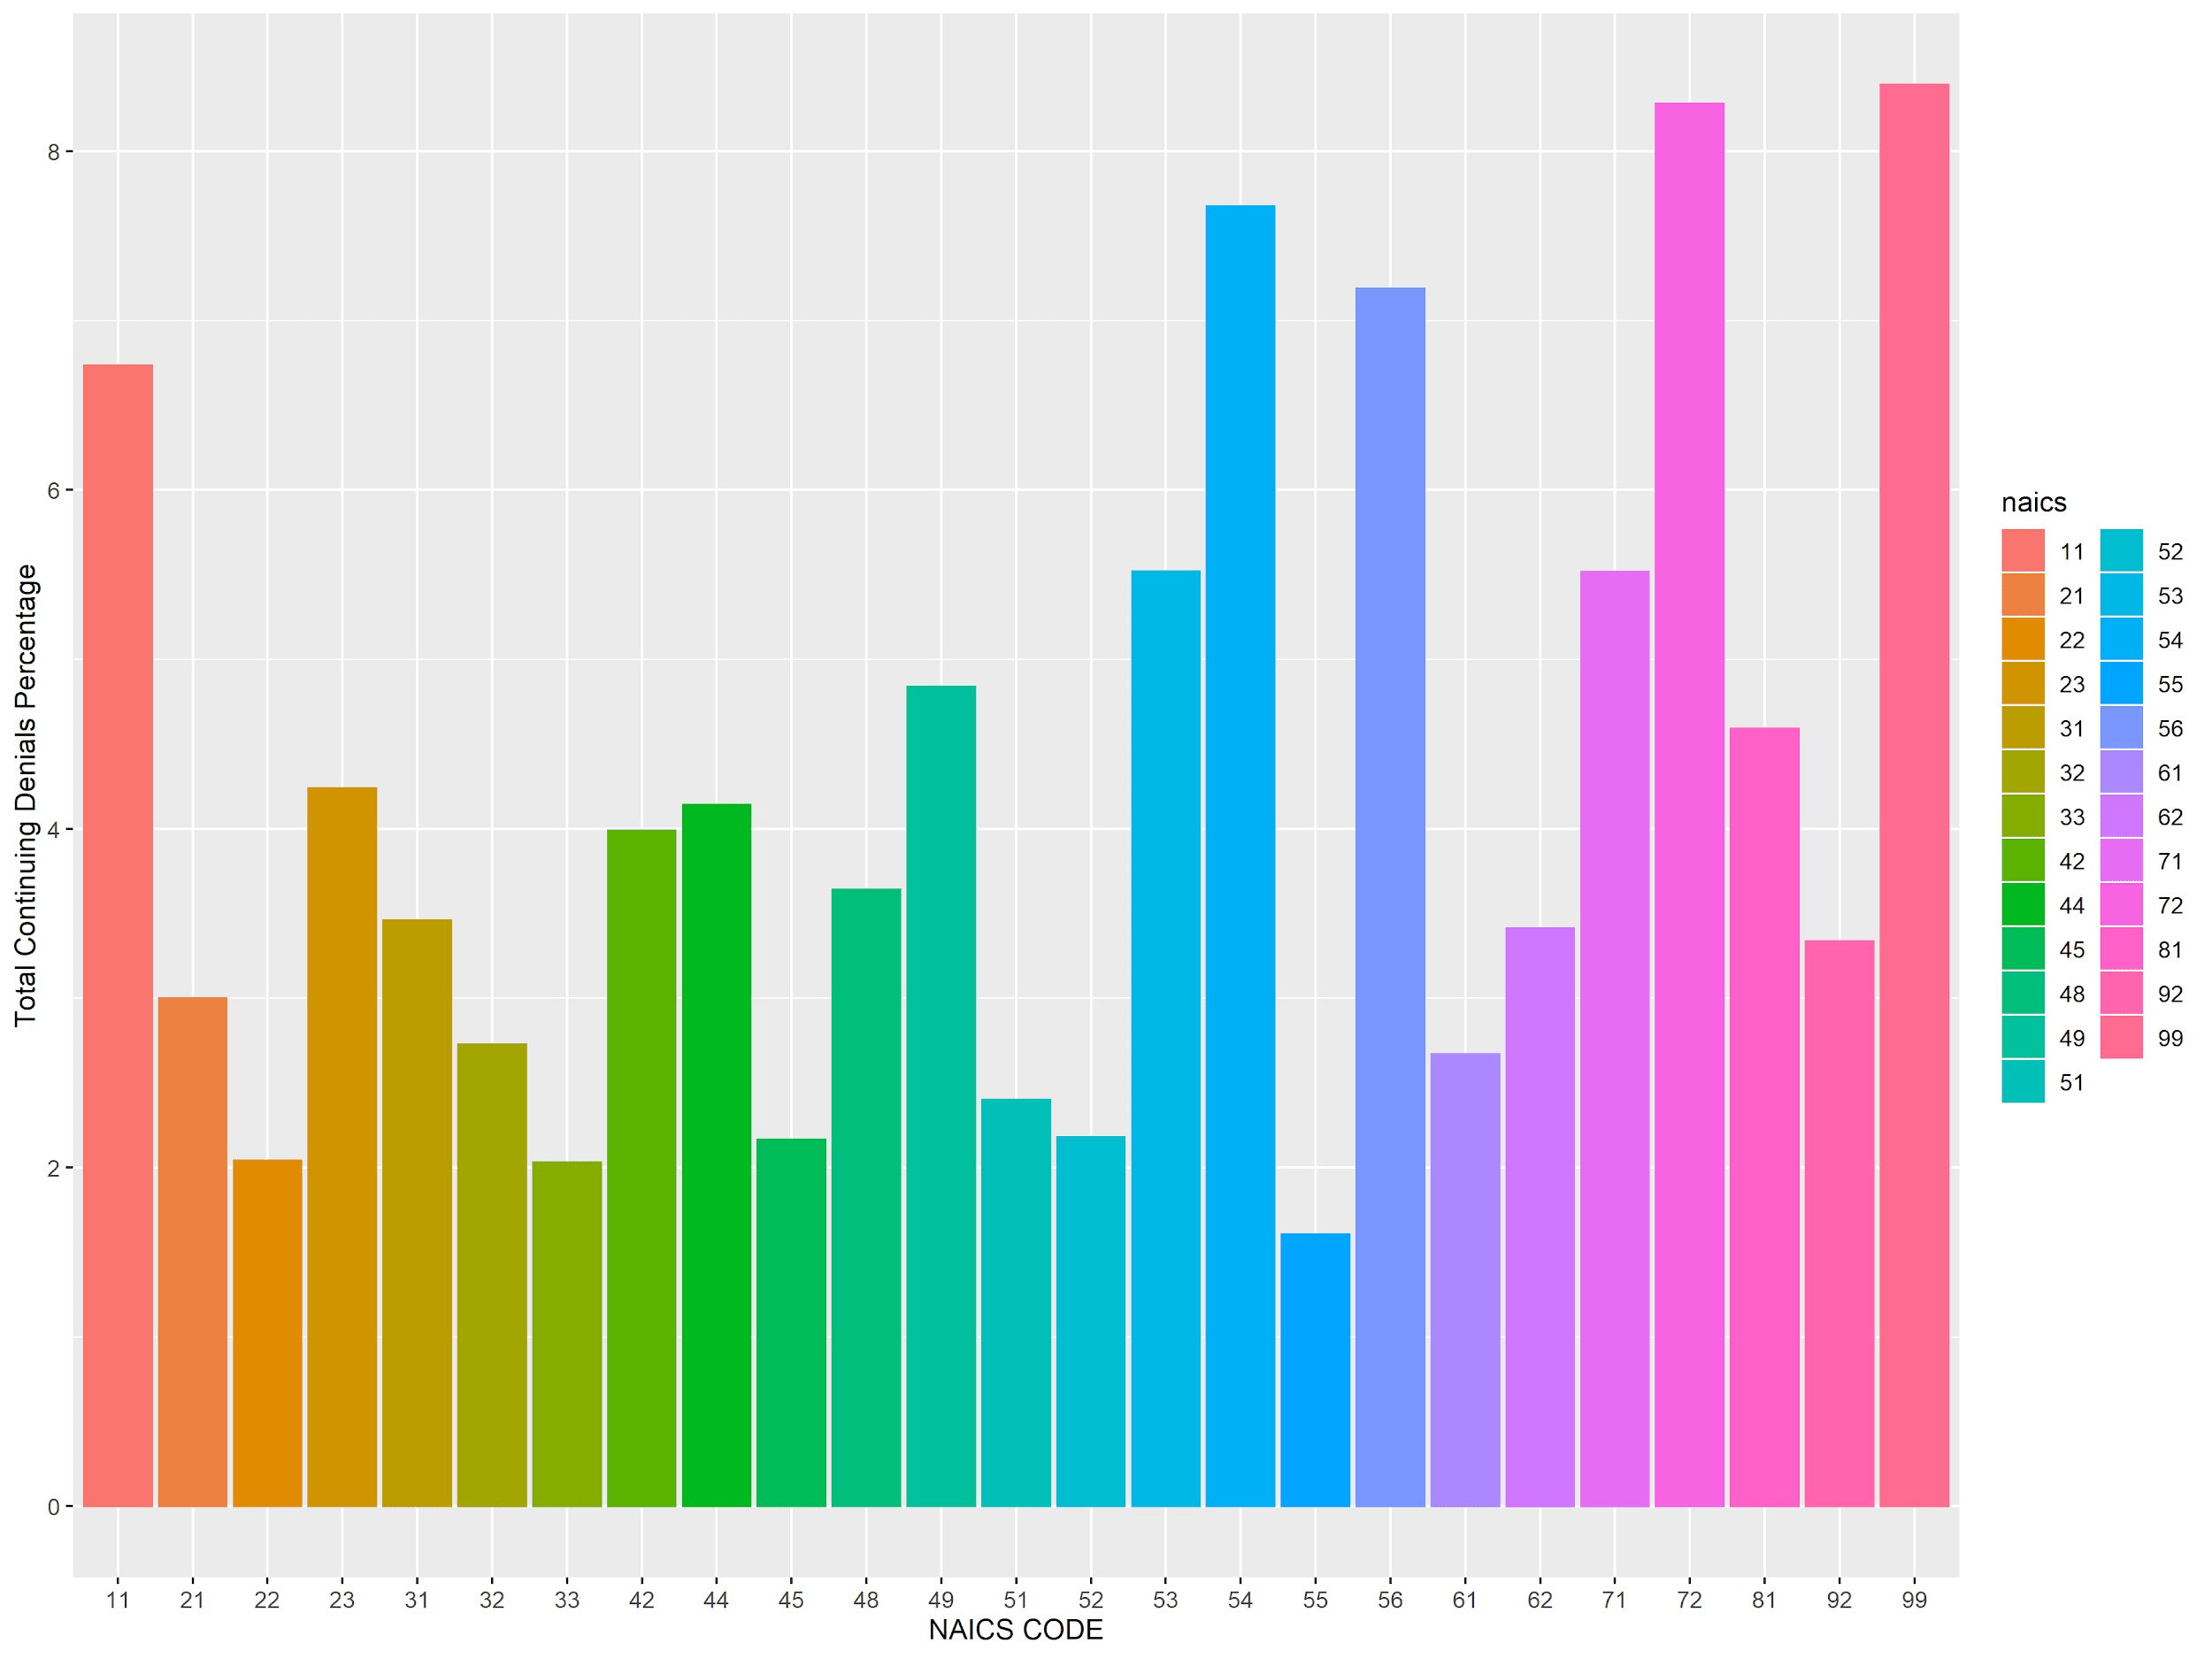
Factor II - Industry (Continue)
Industries vs NAICS
Total Continuing Denial Percentage
55(Management of Companies and Enterprises):
Eight major investment banks increased high-skilled workers by almost 60% over 5 years
Hard to fill with U.S workers
99(Nonclassifiable Establishments):
Industry is unknown. Any petition that had a blank code was assigned as 99 as well.

Slide 15
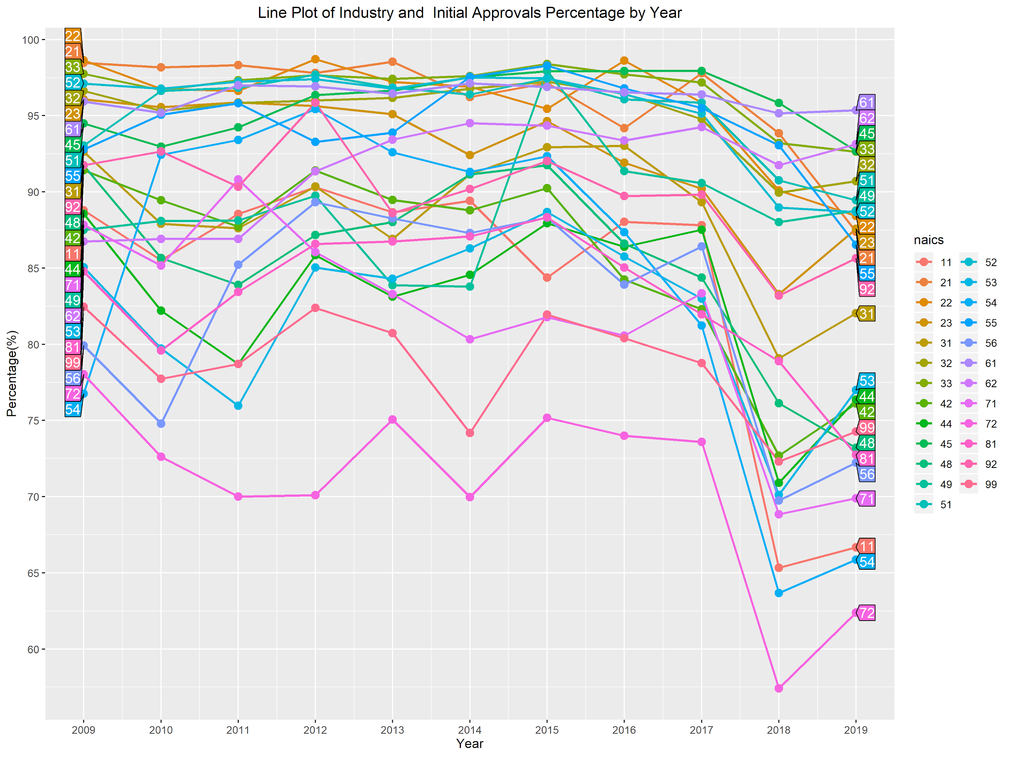
Factor II - Industry (Continue)
Industries vs NAICS by Year
Total Initial Approval Percentage
54(Professional, Scientific, and Technical Services):
2010(increase 15.68%):
IT industry growth after recession.
2018(decrease 29.37%):
Become “sensitive” subject
Increase numbers of applicants
Cost and paperwork increase due to the policy.

Slide 16
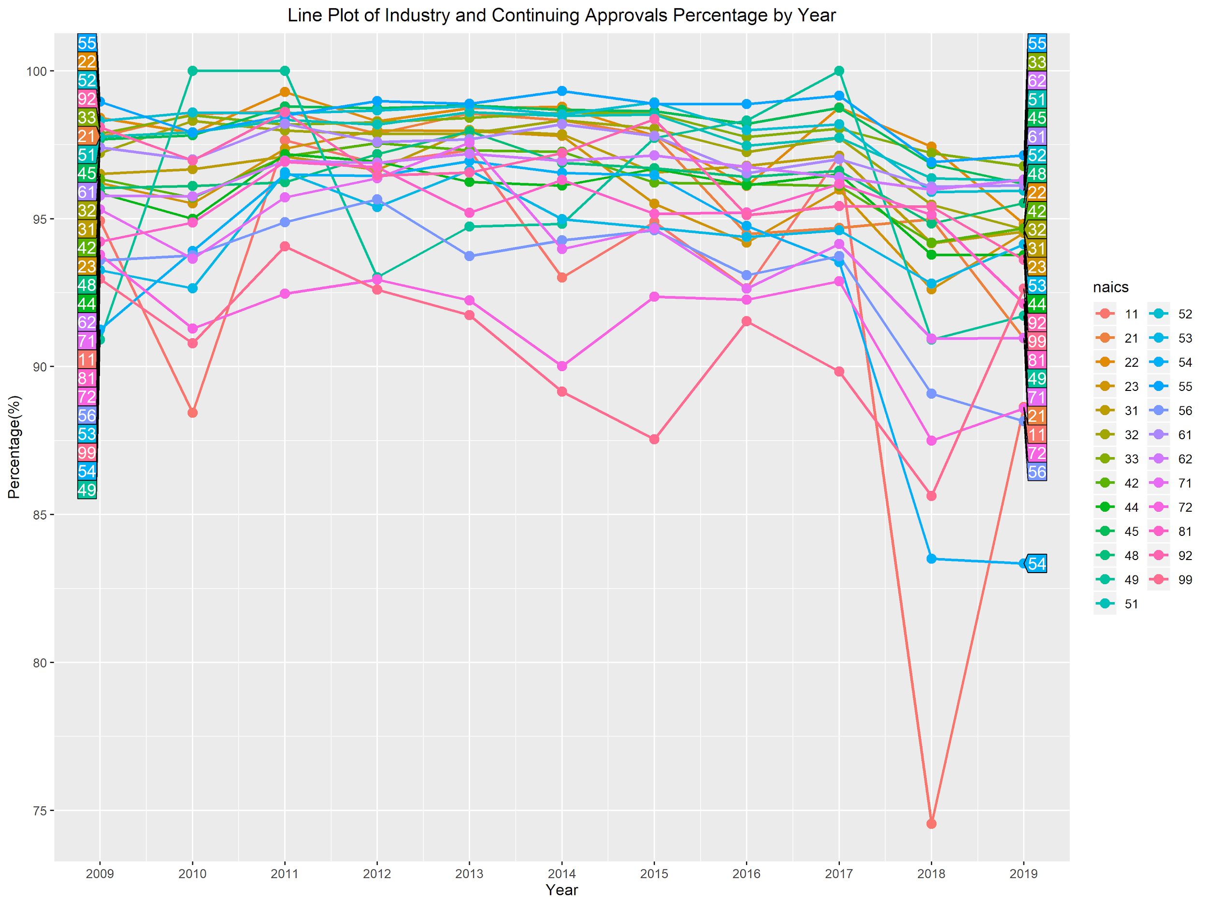
Factor II - Industry (Continue)
Industries vs NAICS by Year
Total Continuing Approval Percentage
11(Agriculture, Forestry, Fishing and Hunting):
Donald Trump’s executive order
Shift to Temporary Non-Agricultural Workers (H-2A)

Slide 17
Factor III:
Year (& Policy)

Slide 18
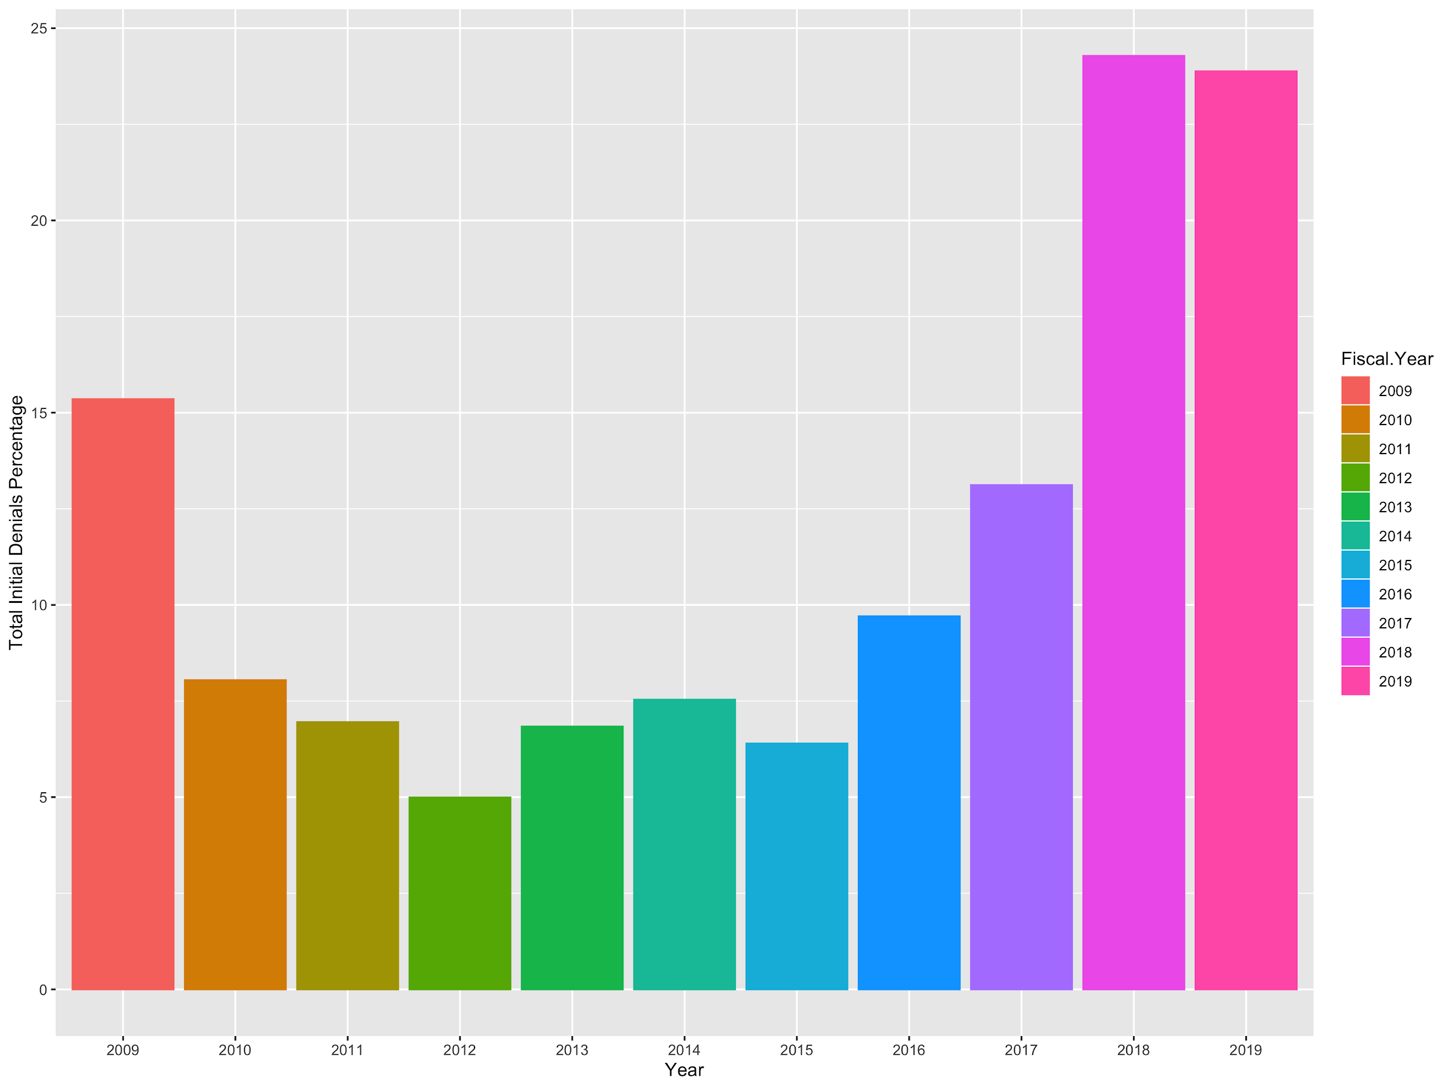
Year & Total Initial Denial Percentage
2012 to 2018:
Increased from 5% to 24%
2015 to 2019:
Increase from 7% to 23%

Slide 19
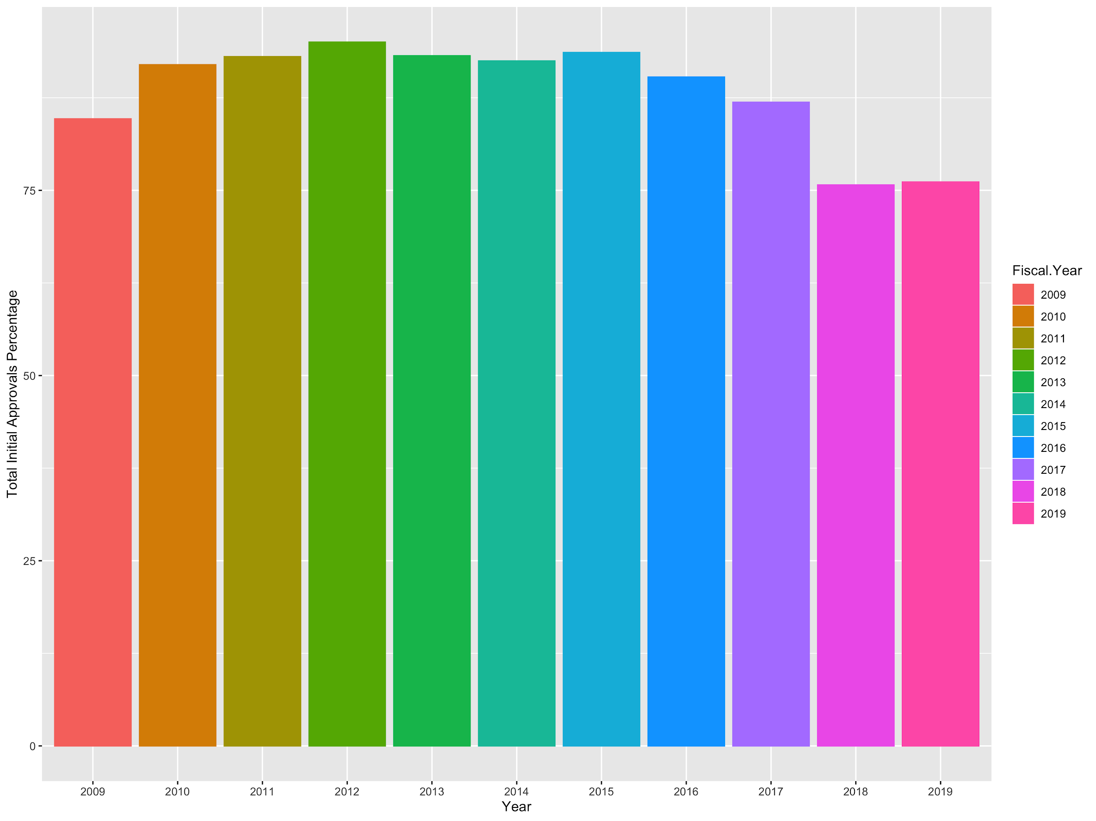
Year & Initial Approvals
2017-2019:
87% approval down to 75% approval

Slide 20
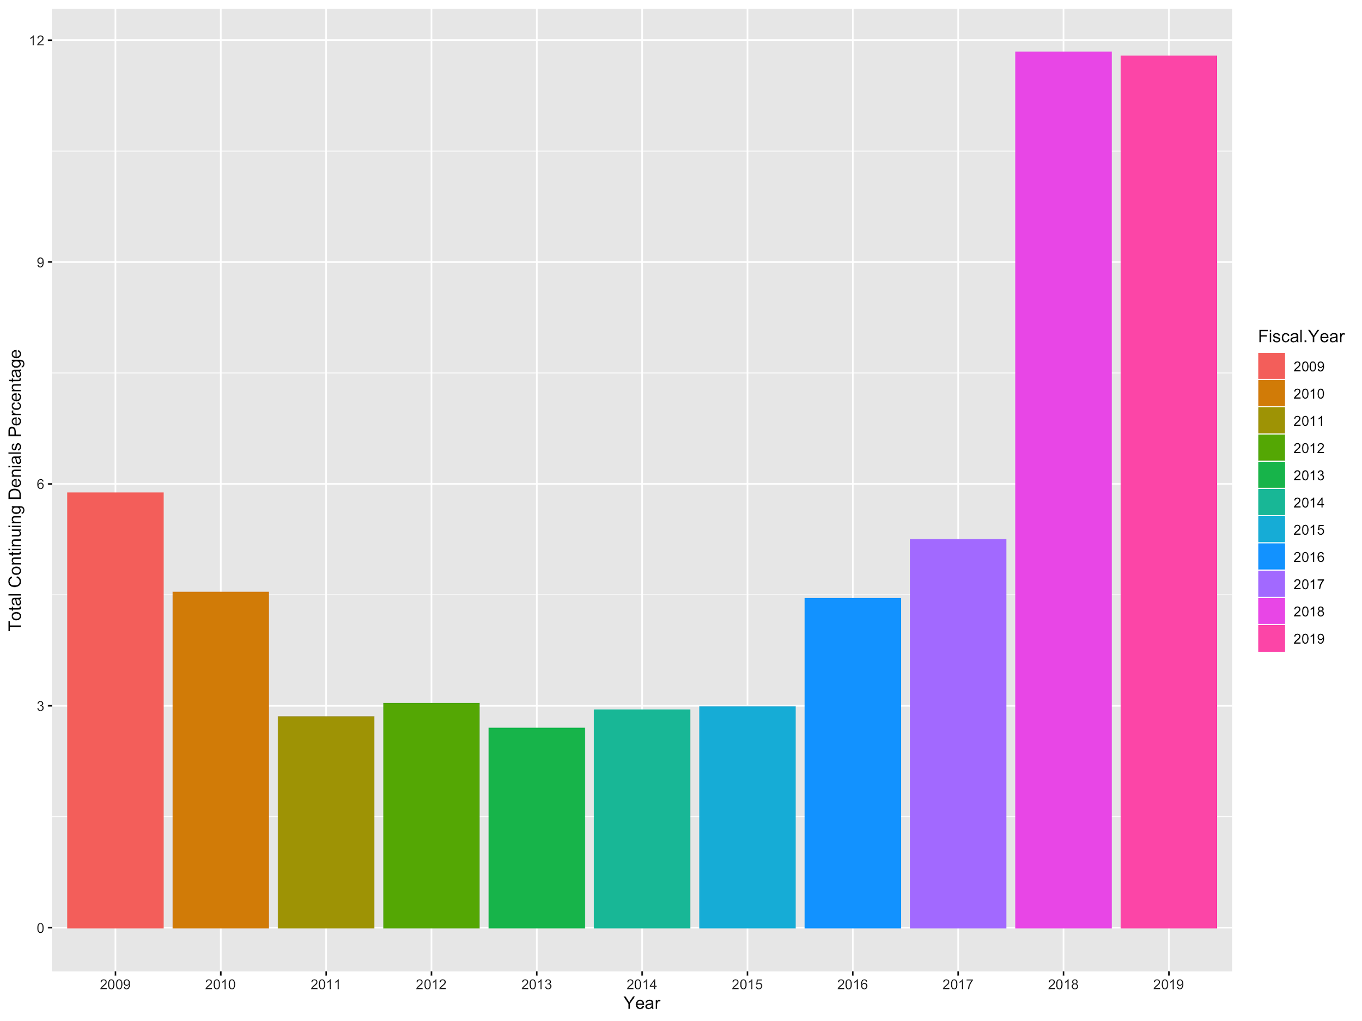
Year & Total Continuing Denial Percentage
2009 - 2019:
Increased from 6% to ~12%
2013 - 2018:
Increase from <3% to ~12%

Slide 21
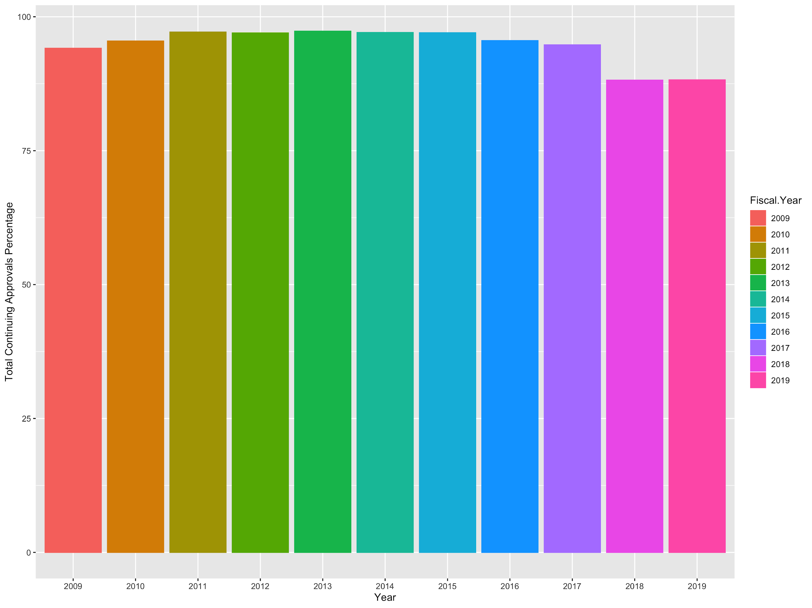
Year & Continuing Approval
2017 - 2019:
93% approval down to 87% approval

Slide 22
Policy
Between FY 2010 and FY 2015, denial rate never went over 8%
From 2015 to 2019, initial denial tripled from 7% to 23%
Form 2015 to 2019, continuing denial quadrupled from 3% to 12%
Why?
US Citizenship and Immigration Services policies and procedures
They have raised the “standard of proof” for accepting H1b visas
The “Buy American and Hire American” executive order
Began in April 2017
“merit-based” immigration instead of “skill-based”
Has affected industry, cities/states labor force, and total foreign labor in US job market

Slide 23
Next steps
NAICS vs Location
...

Slide 24



